Slide 1
K nearest neighbors algorithm
Parallelization on Cuda
Prof. Veljko Milutinović
Maša Knežević 3037/2015

Slide 2
K nearest neighbors algorithm
Classification algorithm.
Supervised learning.
Instance-based learning – method for classifying objects
based on closest training examples in the feature space.

Slide 3

Simple KNN Algorithm
Whenever we have a new point to classify,
we find its K nearest neighbors from the training data.
The distance is calculated using the Euclidean Distance.
$$\text{d}\text{xy}=\sqrt{\sum_{i=1}^{n}{{(xi −yi)}^{2}}}$$

Slide 4
Simple KNN Algorithm
Add each training example <x, f(x)>
to the list of training_examples.
Given a query instance x_{q} to be classified,
  Let x₁, x₂, … , x_{k} denote the k instances from training_examples
  that are nearest to x_{q}.
  Return the class that represents the maximum of the k instances.

Slide 5
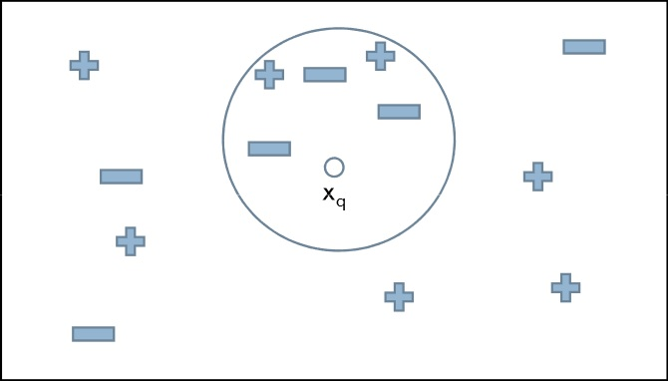
KNN Example
If K = 5, the query instance x_{q} will be classified as negative since the majority of its neighbors are classified as negative.

Slide 6
KNN implementation
The user sets a value for K which is supposed to be odd.
Two thirds of the data set is used for training,
one third for testing.
The training examples are put into a list.

Slide 7
KNN implementation
Testing the algorithm consists of
comparing one test sample to all of the training examples.
The Euclidean distance is found for all the training examples.
The list is then sorted,
the first K are taken into consideration
when searching for the class of the test example.

Slide 8
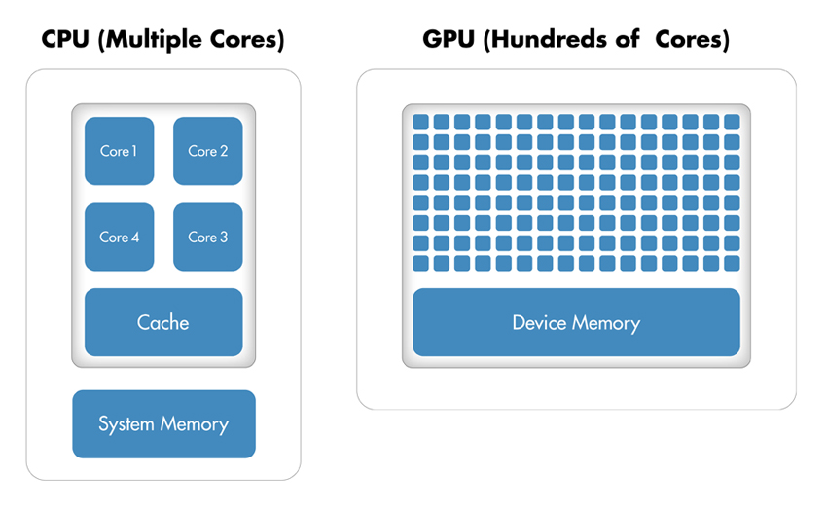
Parallelization on GPU

Slide 9
KNN on GPU
Calculation of the Euclidean distance
between the query instance x_{q} that needs to be classified
and a training example.
Sorting algorithm to sort the training set
in order to easily find the first K nearest neighbors.

Slide 10
Example Task
Determine if a patient has diabetes
using the attributes given in the data set, such as:
triceps skin fold thickness, body mass index, diabetes pedigree function, age …
Public data set – Pima Indian Diabetes Data Set (https://archive.ics.uci.edu/ml/machine-learning-databases/pima-indians-diabetes/) – scaled appropriately for the testing purposes.

Slide 11
Results

Slide 12
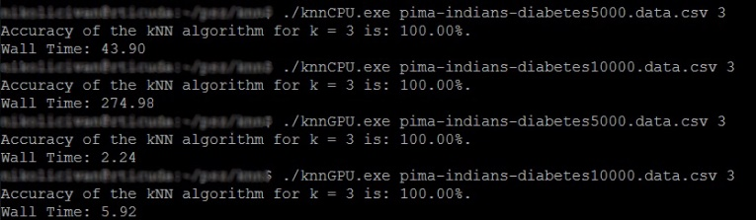
Example Task
Original data set:
Bigger data set:

